Slide 2
Successful Treatment of Hepatoblastoma With Microwave Ablation
John Caniglia, MD, Integrated IR/DR Resident, University of Wisconsin
Joshua Verhagen, BS, Medical Student, University of Wisconsin
Eric Monroe, MD, Professor (CHS), University of Wisconsin
Sean Golden, MD, Assistant Professor (CHS), University of Wisconsin

Slide 3
Background Information
Hepatoblastoma is the most common primary liver malignancy in pediatric patients, accounting for over two-thirds of cases. It is most frequently diagnosed in the first two years of life.¹
Treatment advances have greatly improved the prognosis of hepatoblastoma with cure rates increasing from 30% to over 70% since the 1970s.²
While the current standard of care is neoadjuvant chemotherapy and surgical resection, there is a growing role for interventional oncologic therapy.

Slide 4
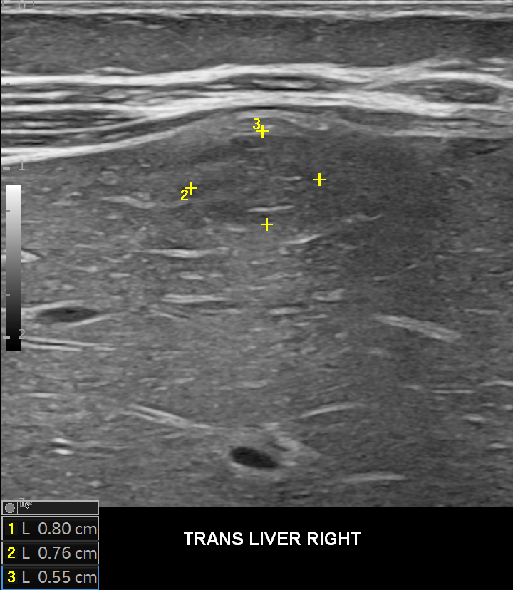
Clinical Presentation
15 month old patient with complex medical history significant for prematurity, VACTERL, and congenital heart disease presented with a liver mass detected incidentally on abdominal ultrasound (Fig. 1).
Lab workup was notable for AFP 192 ng/mL (normal 0-8.8).
Fig. 1 – Transabdominal ultrasound demonstrates 8 mm rounded hypoechoic mass in the periphery of the right hepatic lobe with internal vascularity (not shown).

Slide 5
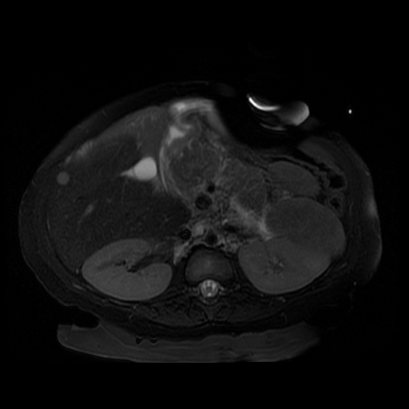
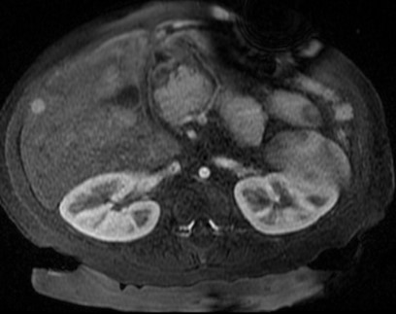
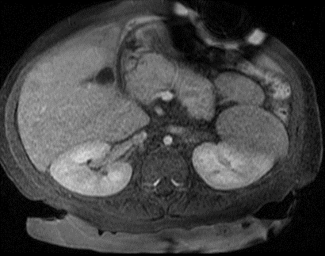
MRI Abdomen
MRI was obtained and demonstrated a round, 8 mm, T2 hyperintense, arterially enhancing lesion in segment 6 with washout on portal venous phase (Fig. 2). Bowel loops were noted within 1 cm of lesion.
A
B
C
Fig. 2 – MRI demonstrates round, 8 mm T2 hyperintense (A), arterially enhancing (B) lesion in segment 6 with washout on portal venous phase (C). Partially imaged bowel loops are noted within 1 cm of lesion, anterior to the liver (blue arrow).

Slide 6
What diagnosis or diagnoses could be compatible with these imaging findings?
Hepatocellular carcinoma
Hepatic abscess
Infantile hepatic hemangioma
Hepatoblastoma
A or D

Slide 7
Answer: E
The most correct answer is E, HCC or hepatoblastoma. Although exceedingly rare in this age group, hepatocellular carcinoma typically demonstrates moderate T2 hyperintensity with arterial phase enhancement and portal venous phase washout, as in this case. ³
Hepatoblastoma typically displays greater degrees of T2 hyperintensity compared to HCC. These lesions enhance heterogeneously on arterial phase imaging and often show areas of necrosis or hemorrhage.³
Hepatic abscesses typically show surrounding edema on T2 sequences, peripheral enhancement, and restricted diffusion. An abscess would not wash out on portal venous phase imaging. ³
Infantile hematic hemangiomas are characteristically T2 hyperintense with early peripheral and nodular enhancement that gradually fills in centrally.³
The patient in this case underwent ultrasound guided biopsy with a diagnosis of hepatoblastoma, epithelial subtype.

Slide 8
What is the PRETEXT classification of this lesion?
I
II
III
IV

Slide 9
Answer: A
PRETEXT (PRE-Treatment EXtent of Tumor) is a classification system based on the number of contiguous liver quadrants that would have to be resected to remove a tumor. This system has been shown to be a predictor of mortality in hepatoblastoma and hepatocellular carcinoma in pediatric patients. PRETEXT I is associated with the best outcomes and PRETEXT IV is associated with the worst.⁴
Only tumors isolated to the left lateral (II, III) or right posterior (VI, VII) segments can classify as PRETEXT I. Since this lesion is localized to hepatic segment VI, it is a PRETEXT I tumor and would therefore be amenable to surgical resection in most cases.
The patient in this case was deemed a poor surgical candidate for liver resection due to comorbidities. Due to the small size of the tumor and lack of additional sites of disease, microwave ablation was offered for local control.

Slide 10
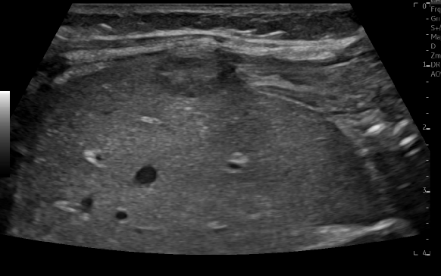
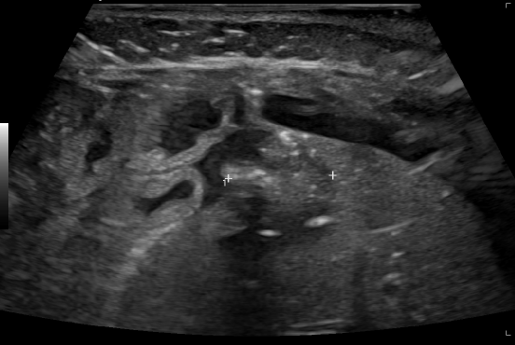
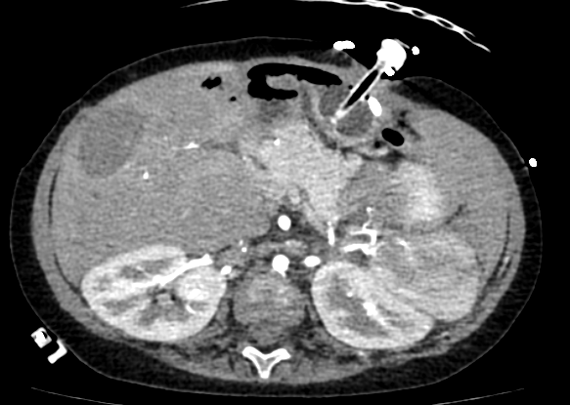
Microwave Ablation
Hydrodissection was performed with 400 mL saline injected via two 18-g blunt tip needles which were then used to displace adjacent bowel.
The lesion was then targeted via ultrasound and ablation was performed for 1 min at 65 W and 1 min at 45 W using a single probe (Neuwave XT, Johnson & Johnson, New Brunswick, NJ).
Post-ablation imaging with ultrasound and CT demonstrated satisfactory coverage without residual disease.
A
B
C
Fig. 3 - Pre-ablation ultrasound imaging (A) demonstrates adequate target visualization. Post-ablation (B) ultrasound and arterial phase CT (C) images demonstrate satisfactory coverage of the tumor in the ablation cavity. Perihepatic fluid from hydrodissection is visible on image B.

Slide 11
Post-ablation, AFP levels normalize. However, the patient remains in the intensive care unit undergoing treatment for atrial ectopic tachycardia. What is the next best step in management?
Two cycles cisplatin chemotherapy
Resection of the ablation cavity
Serial AFP monitoring
Transarterial chemoembolization

Slide 12
Answer: C
The standard treatment for hepatoblastoma involves neoadjuvant and adjuvant cisplatin chemotherapy in combination with surgical resection.² Cisplatin, however, is known to cause significant electrolyte disturbance. In this patient with congenital heart disease, the risk of precipitating further arrhythmia outweighs the benefits of chemotherapy.
Surgical resection is performed for most patients with hepatoblastoma. However, it would not be the correct choice following complete ablation of this patient’s tumor, particularly given comorbidities.
Transarterial chemoembolization has been performed prior to ablation and as stand-alone treatment of hepatoblastoma with promising results.⁵ TACE would not have a role in this patient whose tumor was completely covered within the ablation cavity.
The AFP level has continued to decline in this patient and remains within normal limits 1 year following treatment. Repeat MRI does not show any evidence of recurrent disease.

Slide 13
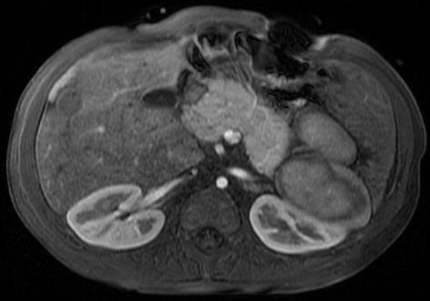
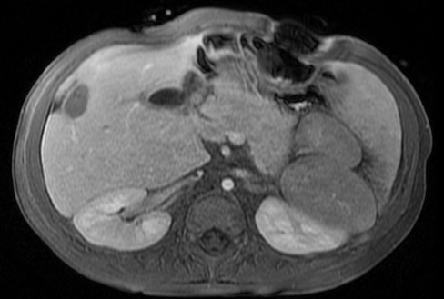
Follow-up
1 year post-ablation, MRI shows no evidence of recurrent disease and AFP remains normal.
A
B
Fig. 4 – MRI with contrast demonstrates expected post-ablative changes with no enhancement on arterial (A) or venous (B) phases to indicate recurrent disease.

Slide 14
Discussion
Microwave ablation is a viable treatment alternative with curative potential in patients with PRETEXT I hepatoblastoma that are poor surgical candidates.
Interventional oncologic therapies, particularly TACE/TARE with or without follow up ablation, have been used in select settings with promising results. ⁵⁻⁷
This case highlights a growing role for interventional oncologic therapy in the treatment of pediatric liver tumors. Further research is needed to evaluate efficacy and identify appropriate candidates.

Slide 15
References
Ranganathan, S., Lopez-Terrada, D., & Alaggio, R. (2020). Hepatoblastoma and Pediatric Hepatocellular Carcinoma: An Update. Pediatric and Developmental Pathology: The Official Journal of the Society for Pediatric Pathology and the Paediatric Pathology Society, 23(2), 79–95. https://doi.org/10.1177/1093526619875228
Musick, S. R., Smith, M., Rouster, A. S., & Babiker, H. M. (2021). Hepatoblastoma. PubMed; StatPearls Publishing. https://www.ncbi.nlm.nih.gov/books/NBK534795/
Meyers, A. B., Towbin, A. J., Serai, S., Geller, J. I., & Podberesky, D. J. (2011). Characterization of pediatric liver lesions with gadoxetate disodium. Pediatric Radiology, 41(9), 1183–1197. https://doi.org/10.1007/s00247-011-2148-6
Towbin, A. J., Meyers, R. L., Woodley, H., Miyazaki, O., Weldon, C. B., Morland, B., Hiyama, E., Czauderna, P., Roebuck, D. J., & Tiao, G. M. (2018). 2017 PRETEXT: radiologic staging system for primary hepatic malignancies of childhood revised for the Paediatric Hepatic International Tumour Trial (PHITT). Pediatric Radiology, 48(4), 536–554. https://doi.org/10.1007/s00247-018-4078-z
Matthew Hawkins, C., Towbin, A. J., Roebuck, D. J., Monroe, E. J., Gill, A. E., Thakor, A. S., Towbin, R. B., Cahill, A. M., & Lungren, M. P. (2018). Role of interventional radiology in managing pediatric liver tumors. Pediatric Radiology, 48(4), 565–580. https://doi.org/10.1007/s00247-018-4072-5
Xianliang, H., Jianhong, L., Xuewu, J., & Zhongxian, C. (2004). Cure of hepatoblastoma with transcatheter arterial chemoembolization. Journal of Pediatric Hematology/Oncology, 26(1), 60–63. https://doi.org/10.1097/00043426-200401000-00018
Aguado, A., Dunn, S. P., Averill, L. W., Chikwava, K. R., Gresh, R., Rabinowitz, D., & Katzenstein, H. M. (2020). Successful use of transarterial radioembolization with yttrium‐90 (TARE‐Y90) in two children with hepatoblastoma. Pediatric Blood & Cancer, 67(9). https://doi.org/10.1002/pbc.28421

